Slide 1
Introduction to Linear Regression

Slide 2
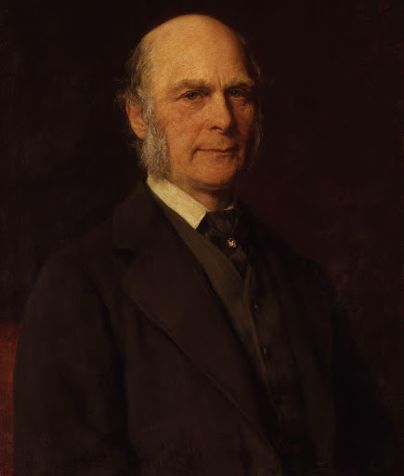
History
This all started back in the 1800s with a man named Francis Galten. Galten was studying the relationship between parents and their children and in particular, he investigated the relationship between the heights of fathers and the heights of their sons. What he discovered was that a man's son tended to be roughly as tall as his father. However Galton's breakthrough was at the son's high tended to be closer to the overall average height of all people. Let's go ahead and take an example of this.

Slide 3
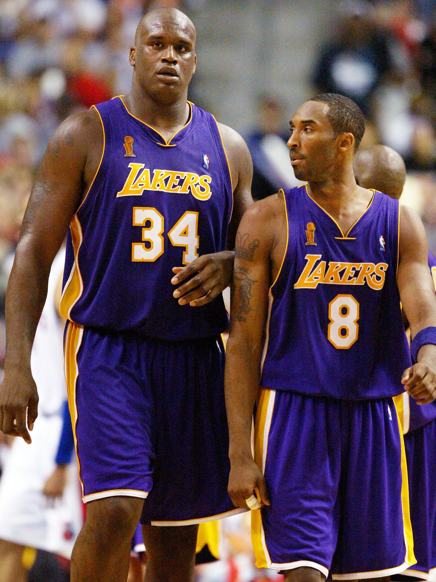
Example
Shaquille O'Neal was a famous NBA player, is very tall. He's 7 foot 1 inch or 2.2 meters tall. If Shaq, as he's known, has a son chances are he'll be pretty tall too. However Shaq is such an anomaly in height that there is also a very good chance that his son is not going to be as tall, as Shaq.

Slide 4

Example
And it turns out this is the case. Shaquille O'Neal son is pretty tall. He's 6 foot seven inches but he's not nearly as tall as his dad who was 7 foot 1 . Golten calls this phenomenon “regression” as in a father’s son’s Height tends to regress or drift towards the mean or average height of everyone else

Slide 5
Example
Simplest possible example:
calculating a regression
with only two data points.

Slide 6
Example
These two little black dots all we're trying to do when we calculate our regression line is draw a line that's as close to every dot as possible
For classic linear regression or the least squares method. You only measure the closeness in the up and down direction..

Slide 7
Example
Now wouldn't it be great if we could apply this same concept to a graph with more than just two data points.
By doing this we could take multiple men and their sons heights and do things like tell Amanda how tall we expect the son to be,, before she even has a son.

Slide 8
Example
Our goal if linear regression is to minimize the vertical distance between all the data points in our line.
So in determining the best line we are attempting to minimize the distance between all the points and distance to our line.
.

Slide 9
Example
There are lots of actually different ways to minimize this. The sum of squares error some of absolute errors etc.. But all of these methods have a general goal of minimizing the distance between your line and the rest of the data points

Slide 10
Example
For example one of the most popular methods that we just described is the least squares method.
Here we have a couple of blue data points along an x and y axes

Slide 11
Example
We want to fit a linear regression line.
And the question is how do we decide which line is the best fitting one ?

Slide 12
Example
We will use the least squares method which is fitted by minimizing the sum of the squares of the residuals the residuals for an observation is the difference between the observation the fitted line.
residuals are marked by the red line. The difference between the true data point in blue and your fitted model line.

Slide 13
End
Next lecture will be Logistic Regression

